Slide 1
Lecture 7:
Automation and Orchestration

Slide 2
Objectives
After studying this chapter, you should be able to:
1. Understand What is SOAR?
2. Understand different aspects of SOAR
3. Why an investigation is essential?
4. Explore common use cases for SOAR
5. Benefits and challenges of orchestration

Slide 3

What is SOAR ?
Security Orchestration, Automation, and Response
It’s a cybersecurity approach that uses automation and coordination to quickly and effectively respond to and manage security incidents.
SOAR is a stack of compatible software programs that enables an organization to collect data about cybersecurity threats and respond to security events with little or no human assistance.
The goal of using a SOAR platform is to improve the efficiency of physical and digital security operations.

Slide 4
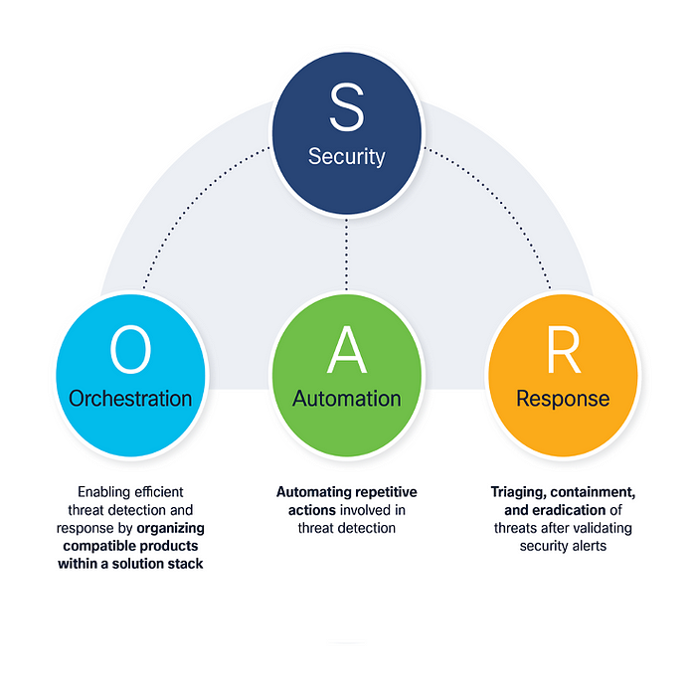
Aspects of SOAR
Security Orchestration:
This encompasses arranging and ordering different security tasks across diverse tools and technologies. For instance, when a security issue arises, SOAR can automatically initiate a series of predefined actions across various security systems.
Automation:
SOAR systems streamline routine and repetitive tasks that security teams would otherwise need to carry out manually. This covers activities such as collecting data, confirming incidents, and executing response measures.
Response:
SOAR simplifies incident management by furnishing playbooks or workflows that direct security analysts through the necessary steps for examining and alleviating threats. These playbooks can be tailored to suit an organization’s specific requirements.

Slide 5
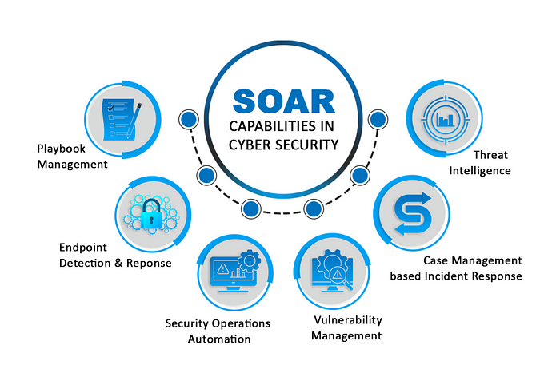

SOAR Capabilities
Workflow Orchestration
Automating Routine Activities
Incident Playbooks
Integration with Security Tools
Threat Intelligence Incorporation
Analyzing and Reporting

Slide 6
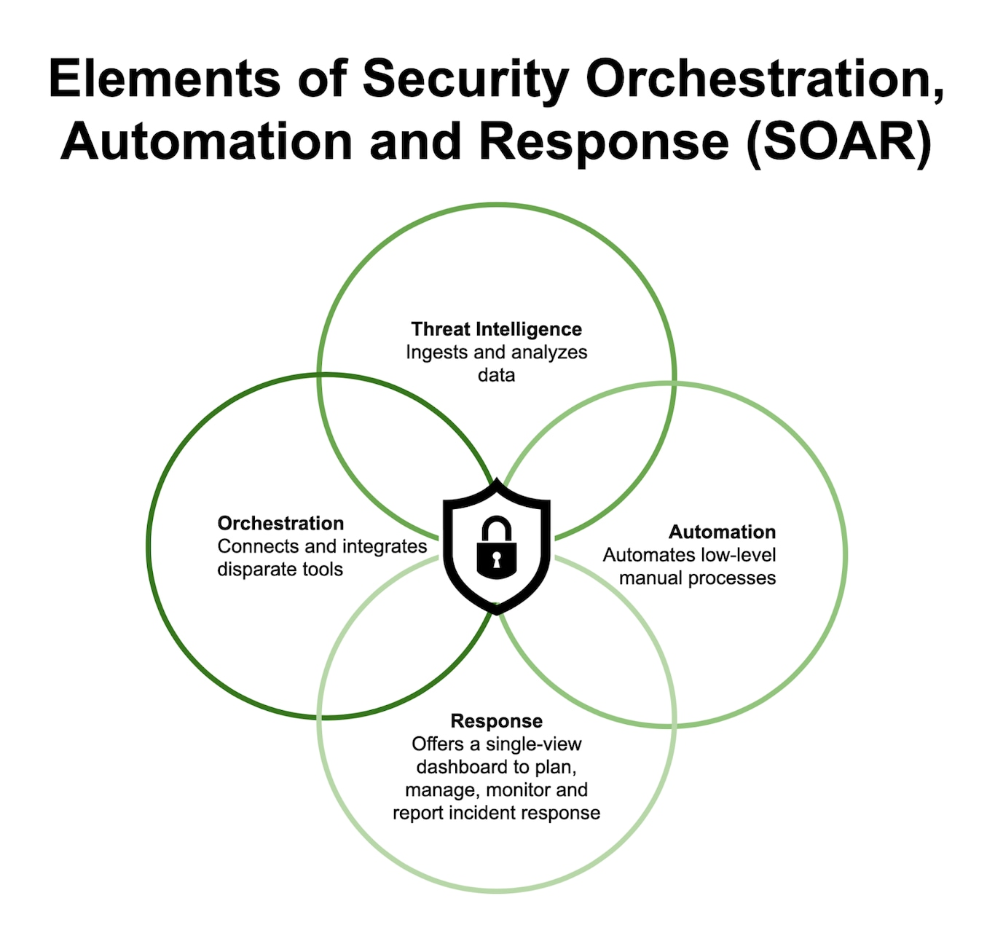

Elements of SOAR
SOAR is a set of security features that helps organizations collaborate on incident investigation and automate certain actions that SOC analysts perform.
As the end goal with SOAR, we want to achieve a faster mean time to acknowledge (MTTA) and mean time to respond (MTTR). The MTTA and MTTR are the two most important measurements for a SOC.
The main elements of SOAR are as follows:
Incident management
Investigation
Automation
Reporting
TI and Threat and Vulnerability Management(TVM)

Slide 7
Security Orchestration Terminology
While learning about security orchestration, keep in mind the following terms:
Security automation: Security automation is the process of executing security tasks using machines instead of humans.
Playbooks: Playbooks, also called runbooks, are task-based graphical workflows that help visualize processes across security products. These playbooks can be fully automated, fully manual, or anywhere in between.
  How to create an incident response playbook: https://www.techtarget.com/searchsecurity/tip/How-to-create-an-incident-response-playbook
Integrations: Product integrations or apps are mechanisms through which security orchestration platforms communicate with other products. These integrations can be executed through Representational State Transfer (REST) APIs, webhooks, and other techniques. An integration can be unidirectional or bidirectional. Bidirectional integrations allow both products to execute crossconsole actions.
Ingestion: Ingestion is a name given to the process through which security orchestration tools consume alerts from other security products.

Slide 8
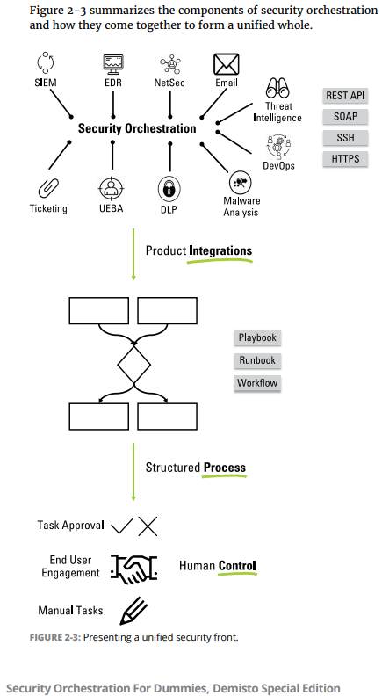


SOAR Security Components

Slide 9

SOAR Security Components
Security information and event management (SIEM): SIEM tools monitor various sources for machine data, correlate and aggregate them for context, and provide real-time detection and monitoring of alerts generated by applications and network hardware. These tools are useful for alert detection and initial enrichment.
Threat intelligence: Threat intelligence tools collect and correlate data from external and internal sources to provide information regarding the malice of an incident or indicator. These tools are useful for alert enrichment.
Endpoint security: Endpoint security tools are responsible for the protection of devices such as laptops, mobile phones, and desktops that are connected to organizational networks. These tools help with detection, enrichment, and response actions.

Slide 10
SOAR Security Components
Network security: Network security tools involve both hardware and software that protect the underlying network infrastructure from misuse or compromise. These tools are a critical part of alert detection.
Email and web gateways: Email and web gateway tools are designed to prevent the transmission of emails or access of websites that break company policy or result in information transfer with malicious intent. These tools are important for response and enforcement.
Ticketing systems: Within security, ticketing systems are usually responsible for assigning tasks, capturing the flow of an incident, and helping deal with incidents in a more effective manner.

Slide 11
SOAR Security Components
Vulnerability management: Vulnerability management tools are responsible for uncovering any potential weaknesses in existing organizational systems that can be exploited by malicious actors.
Cloud Access Security Broker (CASB): For organizations with cloud-based resources, CASBs act as a middle layer between customers and providers to ensure enterprise security policy enforcement.
User and Entity Behavior Analytics (UEBA): UEBA tools monitor and analyze the behavior of users and entities to detect anomalous and potentially malicious intrusions into organizational systems.

Slide 12
Implementing automation in SOC workflows

Slide 13
SOAR Workflows (E.g: Phishing Workflow)
Scenario: THM Corp employees have recently received numerous suspicious emails and have reported them to the SOC team for investigation. As the lead analyst, you wish to develop an automated workflow to analyse email files and perform case management using various security tools.
Phishing attacks remain the most common attack vector used in breaches. Unfortunately for security analysts, investigating phishing emails becomes time-consuming and involves manual exercises such as analysing attachments and URLs.
SOAR solutions can execute these tasks in the background while other investigations are ongoing. Additionally, remediation can be performed when a positive phishing email is identified.
Now, what would this workflow look like? Let’s build a flow of events using our scenario as a security analyst assigned to the incident.

Slide 14
Phishing Workflow
The suspected emails have been received and isolated in a sandbox environment prepared for such events.
A trigger is executed to create a ticket on the case management solution (such as TheHive). This will allow for better documentation and follow-up on the incident.
Parse the email for URLs, attachments and other possible IOCs. If any IOCs are present, they will be extracted.
File hashes will be generated for extracted attachments.
A VirusTotal trigger is executed to analyse extracted URLs and file hashes.
In the event there are no results from VirusTotal, a manual email analysis has to be done to ensure whether it is malicious.
Malicious outcomes from automated or manual analysis trigger a deletion of the malicious email and a communication notification to the organisation.
The incident ticket is updated with IOCs’ results and reports generated.
End of workflow.

Slide 15
Benefits and challenges of orchestration

Slide 16
What are the benefits of SOAR Platform?
Faster incident detection and reaction times.
Better threat context.
Simplified management.
Scalability.
Boosted analyst productivity.
Streamlined operations
Reporting and collaboration
Lowered costs.

Slide 17
Difficulties in SOAR
The primary difficulties in Security Orchestration, Automation, and Response (SOAR) include:
Complex Integration Issue
Challenge of Customization and Workflow Design
Skill Gap and Training Dilemma
Optimizing Alerts and Workflows

Slide 18
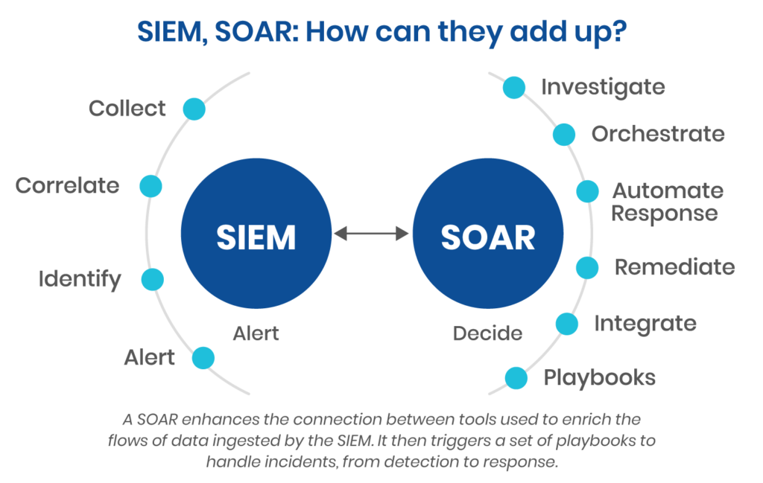
SOAR vs SIEM
Reference: https://www.devo.com/threat-hunting-guide/soar-vs-siem/

Slide 19
SOAR vs SIEM
SIEM | SOAR
Raises alerts; personnel must take action | Intakes alerts and automatically responds
Manual alert triage is required | Automated alert triage
Analytics engine must be manually tuned to differentiate between malicious and benign threats | Automatically differentiates between threats and acts accordingly
Attributed to alert fatigue among analysts | Orchestration and automation capabilities reduces alert fatigue
Basic data correlation capability and takes single decisions to trigger alerts (which may be false positives) | Dynamically pulls data based on decisions in playbooks or after asking for user inputs
Restricted to collecting log data from network, endpoint, cloud, and application | Can also intake human inputs to make on-the-fly decisions to stop threats
Can only raise alerts; security personnel must still analyze each alert and decide on a course of action | Automatically responds to threats and takes appropriate action to protect the organization

Slide 20
SOAR Use Cases
Use Case | Description | Automated Action (Example)
Phishing Email Response | Detect and respond to phishing emails reported by users or email filters. | Automatically isolate the email, check sender reputation, and delete similar emails.
Malware Infection | Handle alerts from antivirus or EDR tools about malware activity. | Quarantine infected endpoints, block file hashes, and notify IT team.
Unauthorized Login Attempt | Detect multiple failed or suspicious logins from unusual locations. | Disable the account, block the IP address, and alert the SOC team.
Suspicious Network Activity | Identify abnormal data transfers or traffic patterns. | Isolate the affected device and block the suspicious connection.
Ransomware Alert | Respond quickly to detected ransomware activity. | Disconnect affected systems and trigger data backup restoration procedures.

Slide 21
SOAR Use Cases
Use Case | Description | Automated Action (Example)
Data Exfiltration | Detect data being sent outside the organization. | Block outgoing traffic, revoke user access, and notify compliance team.
Insider Threat Detection | Identify unusual behavior by internal users. | Suspend user account and generate investigation report.
Threat Intelligence Enrichment | Collect and analyze threat intelligence from multiple sources. | Automatically correlate IPs/domains with internal alerts.
Vulnerability Management | Automate the patching and prioritization process. | Assign tickets for critical vulnerabilities and verify patch completion.
SIEM Alert Triage | Manage large numbers of alerts generated by SIEM tools. | Automatically categorize, enrich, and assign alerts to analysts.

